Slide 1
UAV
Presentation
Group E
Timothy Mah (A0121580R)
Kwok Ngai Tung (A0108484B)
Johan Iswara Ngadimin (A0186471X)
Julius Wanner (A0195873L)
Akshat Sharma(A0196368L)

Slide 2
Overview
Unmanned aerial vehicles(UAV’s) are mainly used for applications such as surveillance and reconnaissance and their demand has been growing in the recent times.
The requirement for better and smaller UAV’s with higher intelligence, obstacle avoidance, better battery life and better path planning has been growing in recent times.

Slide 3
Project objective
For this project, we are required to use a micro UAV equipped with customized sensors for autonomous navigation in a 6m×6m×2m room equipped with cameras for UAV position estimation. Three obstacles in the form of foam cylinders will be placed in the room. We are required to carry out a simulation and flight experiments for the UAV to go through a charted course designed by our algorithms and avoid all obstacles.

Slide 4
Understanding the problems
01
First task is to use path planning algorithms to generate waypoints along a trajectory which avoids all obstacles.
02
Second task is to create a navigational code which allows the drone to take off, land and chart through a defined course. The navigational code combined with the path planners can be used to simulate the movement of the drone.
03
Third task is to perform actual flight experiments and then add safety corridors, introduce minimum snap for a better flight experiment.

Slide 5
Workflow diagram
04
Path Planning
Perform Simulation
Formulate waypoints through a safe flight path
Use Gazebo to add obstacles and perform simulation.
01
03
Navigation
Integrate previous modules
Generate take-off, landing and flight trajectories.
Combine waypoints with navigational code
02

Slide 6
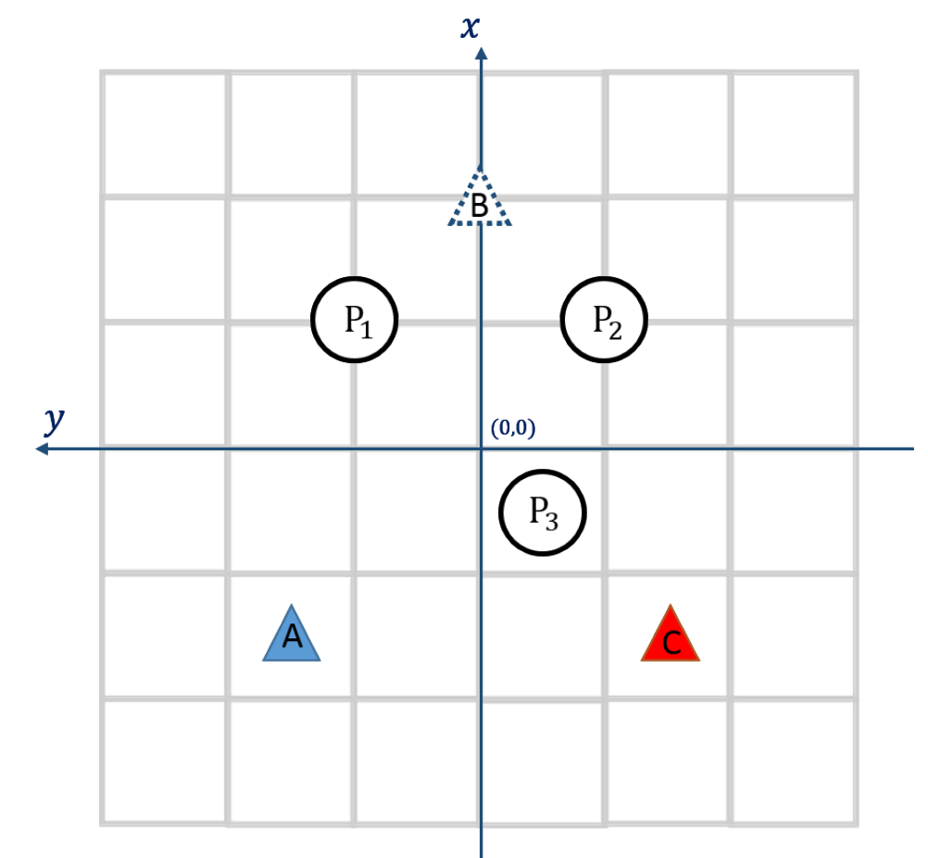
Flight Experiment (Requirements and Constraints)
Take off at point A
Land at point C going through B
The height of the drone should be 1 metre
Velocity over point B should be 0.3 m/s
The distance between the centre of the UAV and the centre of the obstacles should be 0.6 metres

Slide 7
Take-off and Landing
01
Values for speed and acceleration are generated in the z- dimension for every 50 milliseconds which is the sampling rate for the drone.
02
We used the basic kinematic equations to accelerate from the starting height(1m or 0m) in the z direction and then to gain speed.
03
Upon gaining optimal speed along the take off or landing phase, the drone was decelerated in order to get the final velocity to zero.

Slide 8
Navigation between waypoints
01
Values for speed and acceleration are generated in the x,y- dimension for every 50 milliseconds which is the sampling rate for the drone.
02
We used the basic kinematic equations to accelerate from the starting waypoint in the vector towards the final waypoint to gain speed.
03
Upon gaining optimal speed along the target vector, the drone was decelerated in order to get the final velocity to zero upon reaching the final waypoint.

Slide 9
Workflow for flight experiments 1 and 2
Decode obstacles.txt file

Slide 10
Workflow for flight experiments 1 and 2
Decode obstacles.txt file
Design take-off path at A

Slide 11
Workflow for flight experiments 1 and 2
Decode obstacles.txt file
Design take-off path at A
Navigate amongst waypoints.

Slide 12
Workflow for flight experiments 1 and 2
Decode obstacles.txt file
Design take-off path at A
Navigate amongst waypoints.
Design landing path at C

Slide 13
Workflow for flight experiments 1 and 2
Combine waypoints to form path.txt
Decode obstacles.txt file
Design take-off path at A
Navigate amongst waypoints.
Design landing path at C

Slide 14
Path Planning

Slide 15
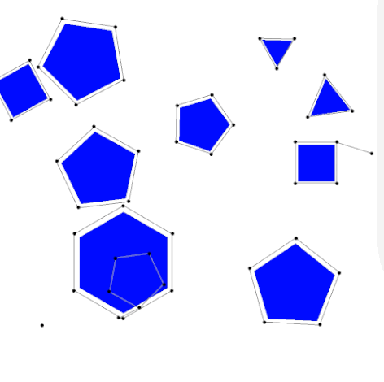
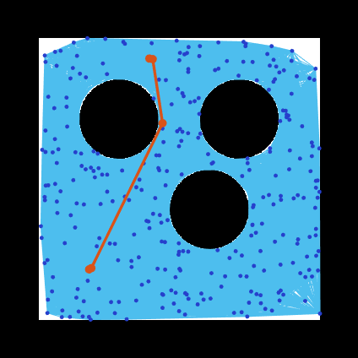
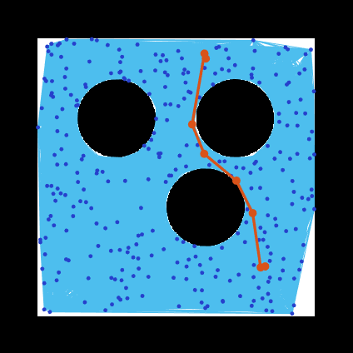
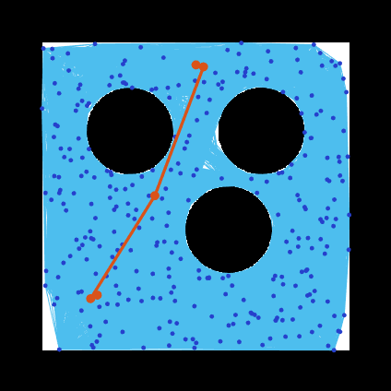
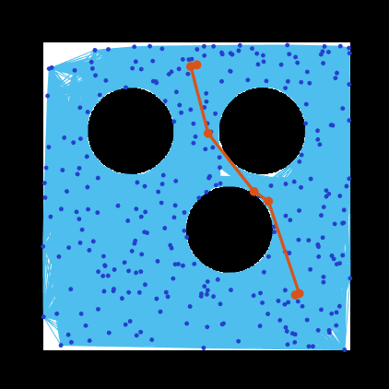
Probabilistic Roadmap (PRM)
Construction Phase
Generate random nodes in free spaces
Create rodmaps from random nodes
Query Phase
Obtain the most optimal roadmap by combining several roadmaps
Flight Case 1 |  | Flight Case 2
Notes:
Probabilistic roadmap (PRM) is one of the considered path planning algorithms used in this project, it generates path from start to end point while also capable of avoiding obstacles lying in between those two points. This technique mainly consists of two main phases, construction and query phase. In construction phase, random nodes are placed in free spaces on map filled with obstacles. Afterwards, several roadmaps were created by connecting those random nodes with their nearest neighbour while taking account to the maximum distance allowed between each node. Finally, in query phase, the most optimal roadmap is obtained by combining the several roadmaps generated previously by using Dijkstra algorithm

Slide 16
Goal Truncation
Aim: Decrease the UAVs path completion time by eliminating waypoints
Solution:
Delete intermediate waypoints on same line
Delete waypoints that are close together
Further intermediate truncation ensuring no collision

Slide 17
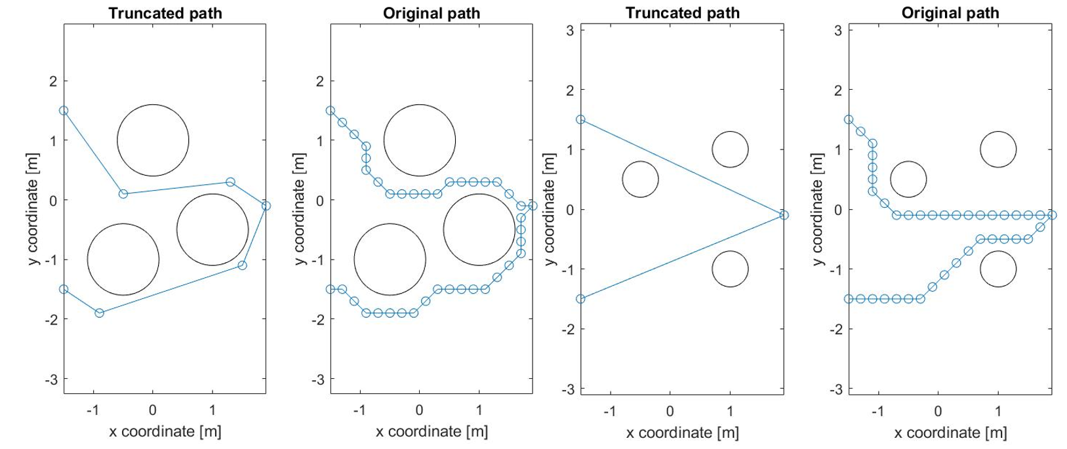
Goal Truncation

Slide 18
Second-order Trajectory

Slide 19
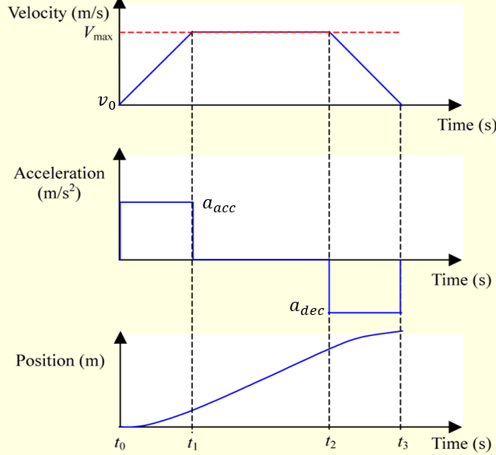
Second order Trajectory planning
Objectives:
Applicable for smooth take-off & landing
Continuous velocity
Waypoint passing velocities v₀ > 0
No overshoot
Limits for velocity and acceleration

Slide 20
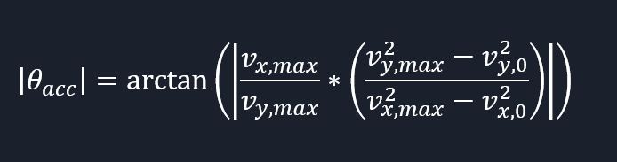
Second order Trajectory planning
Challenge: Maintain goal heading with v₀ > 0 → Find acceleration vector
v₀
v₁ || v_{max} || AB
A
v₁
a?
B

Slide 21
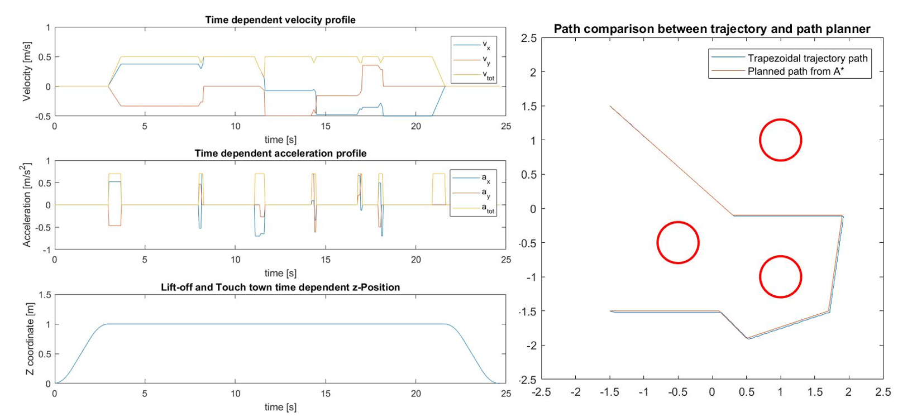
Second order Trajectory planning

Slide 22
Safe Flight Corridor

Slide 23
SFC: Creating ellipses
Goal: Find smallest ellipses that touch cylindrical obstacles
Approach: Reduce minor semiaxis from circle radius until no obstacle collides
R_{inf}
R_{inf}
Obstacle
Obstacle
b_{min}
a = L/2
Path segment of length L

Slide 24
SFC: Creating ellipses
Obstacle fully
OR
partly enclosed in ellipse?
Start circle intersects with obstacle?
Yes
Reduce minor semiaxis b
No
No
Yes
b_{min} = a
b_{min} = b

Slide 25
SFC: Creating ellipses
Obstacle fully
OR
partly enclosed in ellipse?
How to implement?
Start circle intersects with obstacle?
Yes
Reduce minor semiaxis b
No
No
Yes
b_{min} = a
b_{min} = b

Slide 26
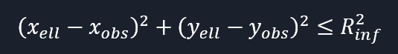
SFC: Creating ellipses
Obstacle center within ellipse?
Any ellipse edge points within obstacle?

Slide 27
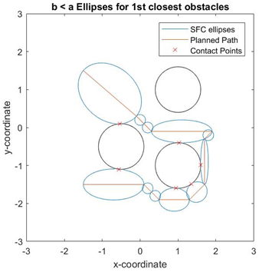
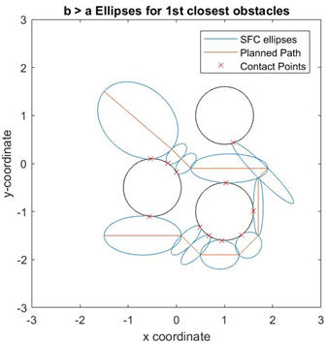
SFC: Creating ellipses
b ≤ a
b ≤ b_{max} with b_{max}> a

Slide 28
Safety Corridor
1. Dimensions of the ellipsoids
2. Coordinates of the intersections
3. The coordinates of the center of the ellipsoids
4. The angle of rotation from the neural orientation

Slide 29
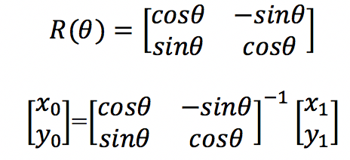
Safety Corridor
Neutral Orientation and at origin (0,0)
Transforming the intersection points:
=
=
=
=

Slide 30
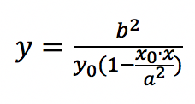
Safety Corridor
Obtaining equation of tangent:
=
=
Tangent

Slide 31
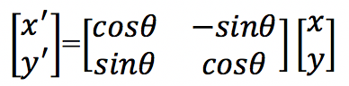
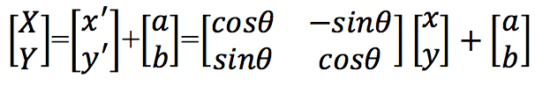
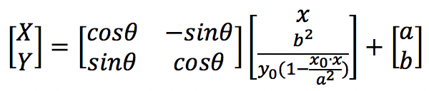
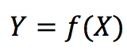
Safety Corridor
Rotating tangent to original position:
Obtaining equation of tangent:
=
=
=
=
2 equations of 3 unknowns, by making x the subject for both the equations, and equating the equations, x can be eliminated
Tangent equation:

Slide 32
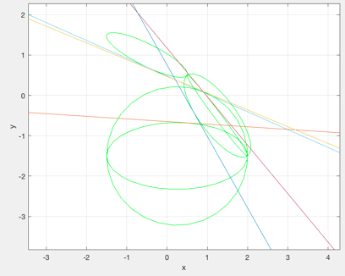
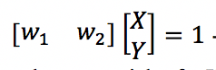
Safety Corridor
Tangent equation:
Manipulate tangent equation:

Slide 33
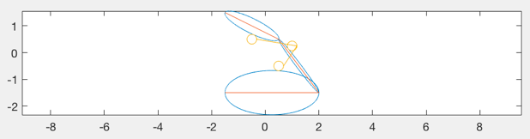
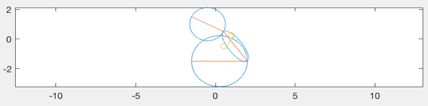
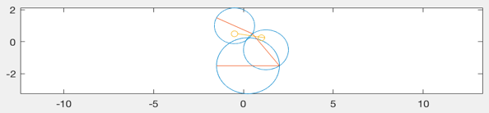
Safety Corridor

Slide 34
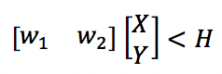
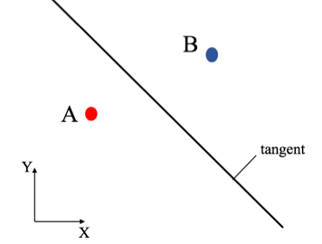
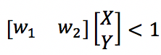
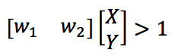
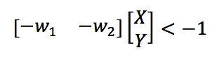
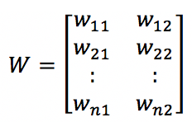
Safety Corridor
To use of QP:
At A:
At B:
W matrix:

Slide 35
Minimum Snap Optimization

Slide 36
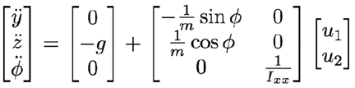
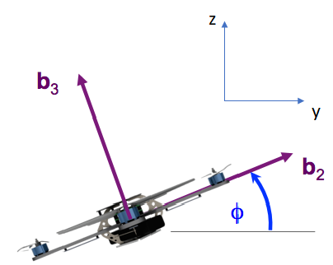
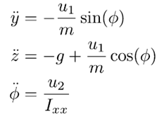
Minimum Snap Trajectory: Motivation
State space model of planar Quadrotor:
Equation of motion (non-linear):
Notes:
To see why we want to use the minimum snap trajectory, we will need to first look at the equation of motion of the quadrotor.
The stated equation of motion is for a simplified model, in which we only assume the quadrotor moves vertically upwards in z direction, and perform pitching to move in y direction. In this model we will not talk about x direction, which is in and out of plane, but the concept is similar to movement in y direction.
So the equation of motion basically relates the vertical thrust force u1, which is in the body frame’s b3 axis, to the y and z direction respectively. It also relates the input angular force to the angular acceleration of the quadrotor in the pitching direction.

Slide 37
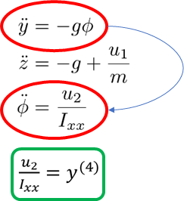
Minimum Snap Trajectory: Motivation
Linearized dynamics
Generate trajectories that minimize the integral of the square of the norm of the snap
Notes:
So by linearizing the dynamics of the quadrotor and by performing simple substitution, we realized that the input for the angular force is actually directly related to the 4th order derivative in the y direction.
Henceforth, we would want to generate a trajectory that minimize such input to the quadrotor, and at the same time, fulfilling all the stipulated constraints and enabling a smooth motion for the quadrotor.

Slide 38
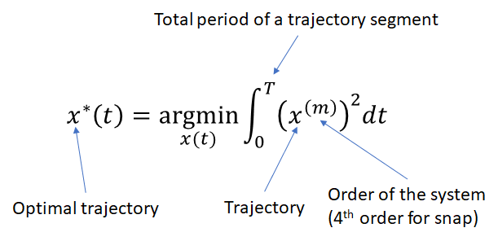
Minimum Snap Trajectory: Motivation
Generate trajectories that minimize the integral of the square of the norm of the snap
Notes:
To do so, we will need to minimize the integral of the square of the norm of the snap, which is a calculus of variation problem

Slide 39
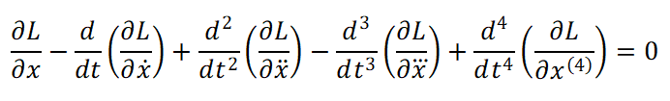
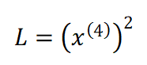
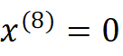
Minimum Snap Trajectory: Optimization
Euler-Lagrange Equation:
Solution to above problem:
Polynomial:
Notes:
To find the minimum of the functional, we solve the problem by using the Euler-Lagrange equation as shown here.
The result of solving the Euler-Lagrange equation is a the 8th order of the polynomial being equal to 0.
When we integrate 8 times, we will obtain the form of polynomial that is of the 7th order.
Now, we will use this as a basis to solve the optimization problem

Slide 40
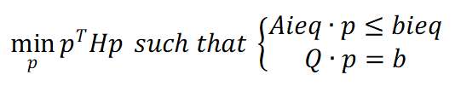
Minimum Snap Trajectory: Optimization
Optimal trajectory (7th order polynomial)
Satisfying various constraints
Equality constraints: Start and end point position, velocity and acceleration; Continuity constraints at each intermediate waypoint
Inequality constraints: Safe Flight Corridors
Formulate into Quadratic programming (QP) problem
Notes:
In this optimization problem, there are constraints that we need to fulfil.
These constraints can be categorized into equality constraints, such as the start and end position, velocity and acceleration, continuity between segments etc, and the inequality constraints in our case here is the safe flight corridors.
One way that we can solve this optimization problem is by formulating it into a quadratic programming problem as shown here below.

Slide 41
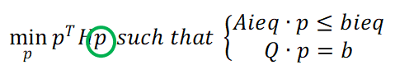
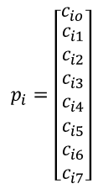
Minimum Snap Trajectory: Optimization
i-th p is the column vector of the coefficients for the i-th polynomial segment
Notes:
Now, I will explain further in detail how we construct the QP problem.
The p as shown here in the objective function is the column vector of polynomial coefficients which we want to find, and it contains individual p_i for each of the polynomial segment.

Slide 42
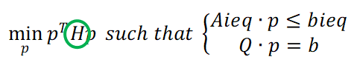
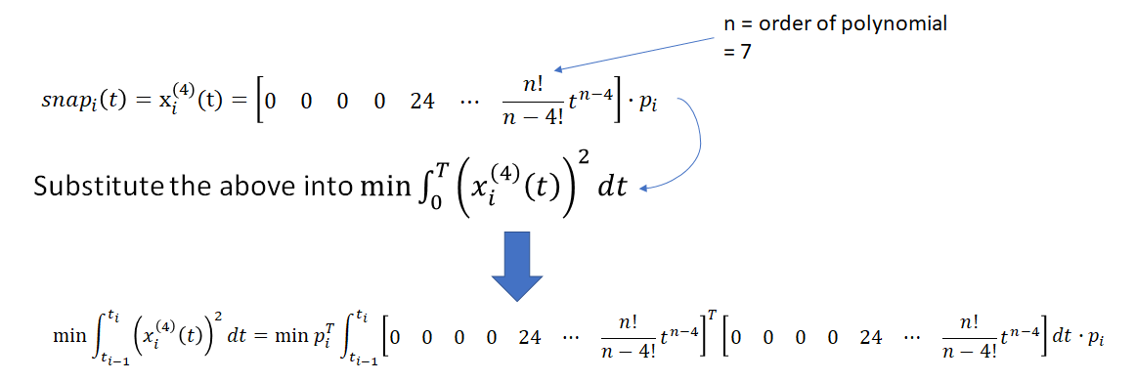
Minimum Snap Trajectory: Optimization
Notes:
Next, the Hessian matrix is as shown.
We first obtain the 4th derivative of the polynomial, and we separate a column vector p_i and a row vector of the time function.
Then, we substitute it into the functional, which we will obtain the expression as shown below

Slide 43
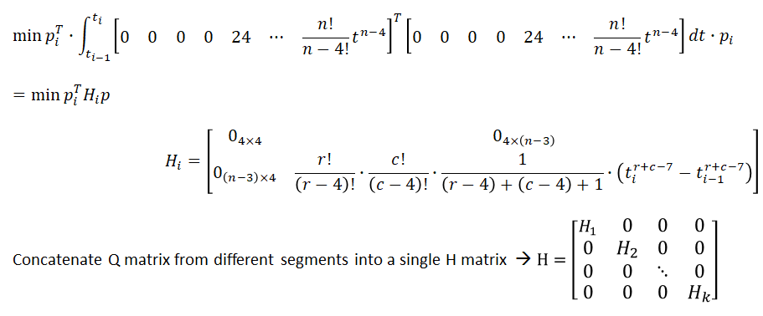
Minimum Snap Trajectory: Optimization
Notes:
The Hessian matrix for the ith polynomial is therefore as shown, and it can be concatenated with other polynomial segments to form a general Hessian matrix for all the polynomial segments.

Slide 44
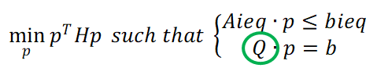
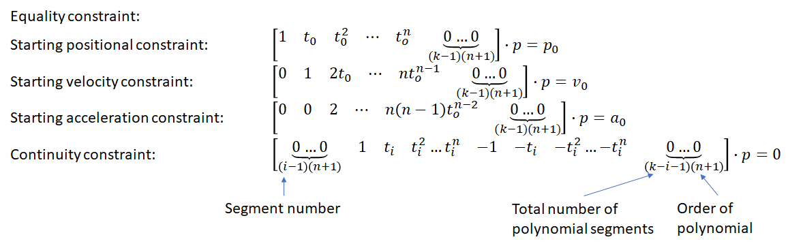
Minimum Snap Trajectory: Constraints
Notes:
Next, I will roughly explain the construction of the constraints equations and inequations.
The equality constraints typically contains the start and end constraints, as well as the constraints involved in the intermediate waypoints.
For example, the start point constraints and the continuity constraints can be derived as shown in this slide.

Slide 45
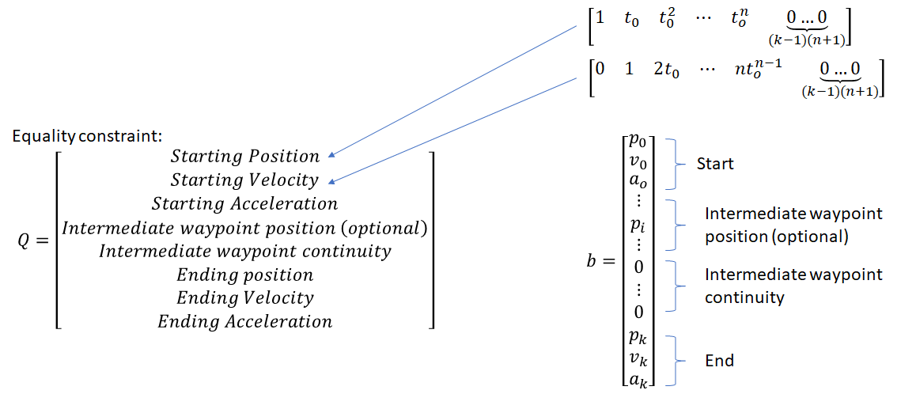
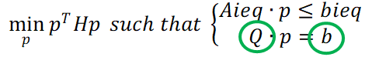
Minimum Snap Trajectory: Constraints
Notes:
Then we put those constraints together into a matrix Q, which consist of a sequence shown here.
Note that these sequence can be arbitrary, but the sequence in the b vector, which contains the constraint values, has to match to the Q matrix.

Slide 46
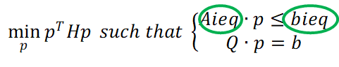
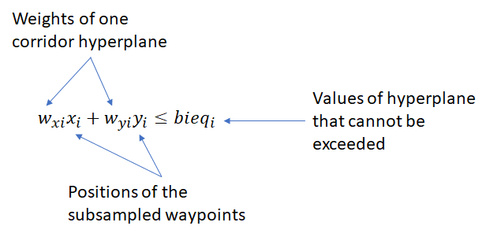

Minimum Snap Trajectory: Constraints
Inequality constraint: For each subsampled intermediate waypoints
Notes:
Now I will briefly explain the incorporation of the corridor constraints into the QP function.
We will first obtain the weights for the respective hyperplanes for the corresponding path segment.
Then we will use the sub sampled points as shown in the illustration on the right. For instance, between the waypoint i and i+1, we will subdivide it into several sub segments.
For each of these subsegments, we will multiple its positions with the corresponding hyperplane weights, and form them into a matrix Aieq

Slide 47


Minimum Snap Trajectory: Constraints
Notes:
A simple structure of the Aieq matrix for either the x and y position is as shown here.
In practice, the Aieq has more columns to the right, because each row has to contain the multiplication of the weights with both the x and y dimensions.
And the production of each of the row with a segment of the column vector of polynomial coefficients p, has to be less than or equal to the stipulated value in bieq vector.

Slide 48

Minimum Snap Trajectory: Constraints
Notes:
So this slide shows the example of the minimum snap trajectory through 5 inflated obstacles, with corridor constraints that is tangent to the obstacles as seen on the left diagram, and fixed square corridors irregards of obstacles and without intermediate waypoint constraints, as shown on the right

Slide 49
Time Optimization

Slide 50

Time Optimization
Notes:
The time optimization was used to shorten the time needed for UAV to complete a mission. It was done by adjusting the time individually between two main waypoints. In practice, when the maximum sampled speed magnitude of all segments exceeds certain value, the program will find which segment generates those result increase the allocated time for that segment only. As a result, the updated time allocation will only affect the timestamp of that segment and maintain the timestamp for other segments.

Slide 51






Time Optimization
Non-Optimized |  | Optimized
Notes:
Without time optimization, the time allocated for each segment need to be set manually. If the time was set to be large value, an optimal trajectory could not be obtained. Meanwhile, if the time was set to be small value, the speed might exceed 1m/s which is the maximum allowed speed. By using time optimization, an optimal trajectory could be generated.

Slide 52

Demo

Slide 53
Thank you!
Questions?

